Slide 1

Internship Experience
First Assessment
Name: Ang Zi Jun, Jeremy

Slide 2
Agenda
Company background
Introduction to Department
Team role
Internship role and project
Self-reflection
Q&A

Slide 3

OCBC Bank is the longest established Singapore bank, formed in 1932.
It is now the second largest financial services group in Southeast Asia by assets.
OCBC Bank subsidiary are:
  OCBC Securities private limited (OSPL)
  Great eastern holdings
  OCBC Wing Hang
  Lion global investors
  Bank of Singapore
  OCBC NISP
  Pac Lease

Slide 4
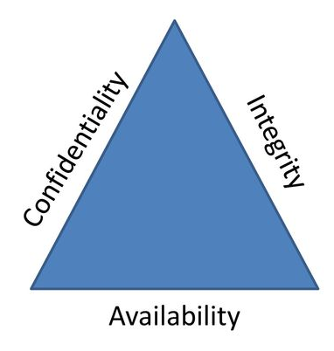
Technology Information Security Office (TISO)
TISO previously known as Information Security Office
Importance of TISO to the OCBC Group
OCBC is 1 of the 11 Critical Information Infra in Singapore
  Safeguard the group’s assets from cyber threats
  (Citizens assets, Singapore reputation, government/business transactions,
  data of Singapore wealth)
  Confidentiality = Sensitive data being exposed
  Integrity = Transaction data being manipulated
  Availability = System/ Network down
  We are the most critical cost centre to the group! We safeguard the bank license!

Slide 5
Capabilities within TISO
Cyber Defence Team
Penetration Test and Vulnerability Scan Team
Project Review Team
Red Team
Cyber Security Engineering Team
Cyber Security Project Team
Cyber Threat Intelligence

Slide 6
My internship role
Cyber Threat Intelligence role is to review cyber threats for the Cybersecurity Operation Centre and Cyber Defence.
To provide intelligence on new cyber threats, vulnerabilities, tactics and procedures used by cyber threat agents.

Slide 7
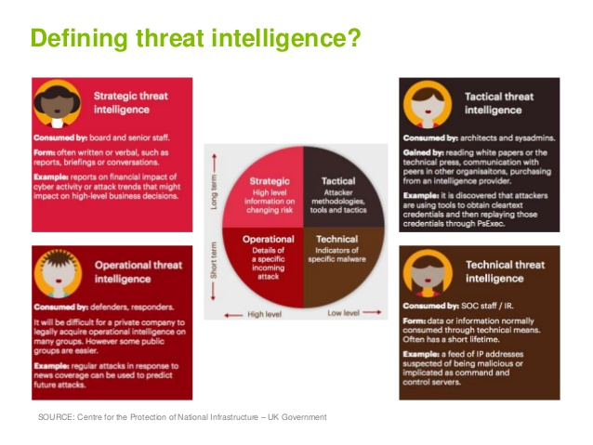

Slide 8
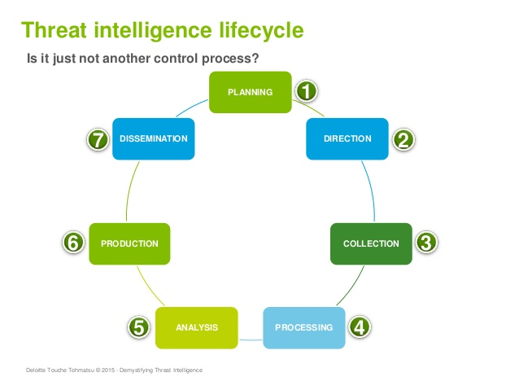

Slide 9
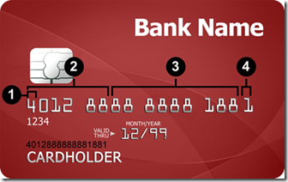

Slide 10
Self-reflection
Strength | Personal development

Slide 11
Conclusion
I gain a lot of invaluable experience.
I learnt work skills from colleague teaching
Since Week 1, a slow progression of personal growth

Slide 13


